Slide 1





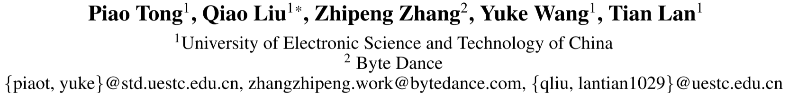





ATAI
Advanced Techniqueof Artificial Intelligence
ATAI
ChongqingUniversity _{AdvancedTechniqueof}
of Technology Artificial Intelligence
Chongqing University of
Technology
Chongqing University ^{ATAI}
_{of Technology} Advanced Techniqueof
Artificial Intelligence
Chongqing University of Technology
Chongqing University of Technology
ScoreNet: Consistency-driven Framework with Multi-side Information Fusion for
Session-based Recommendation
Code: none
2025.8.28 •ChongQing
—— AAAI_2025
Reported by Shiyan Wu
1

Slide 2

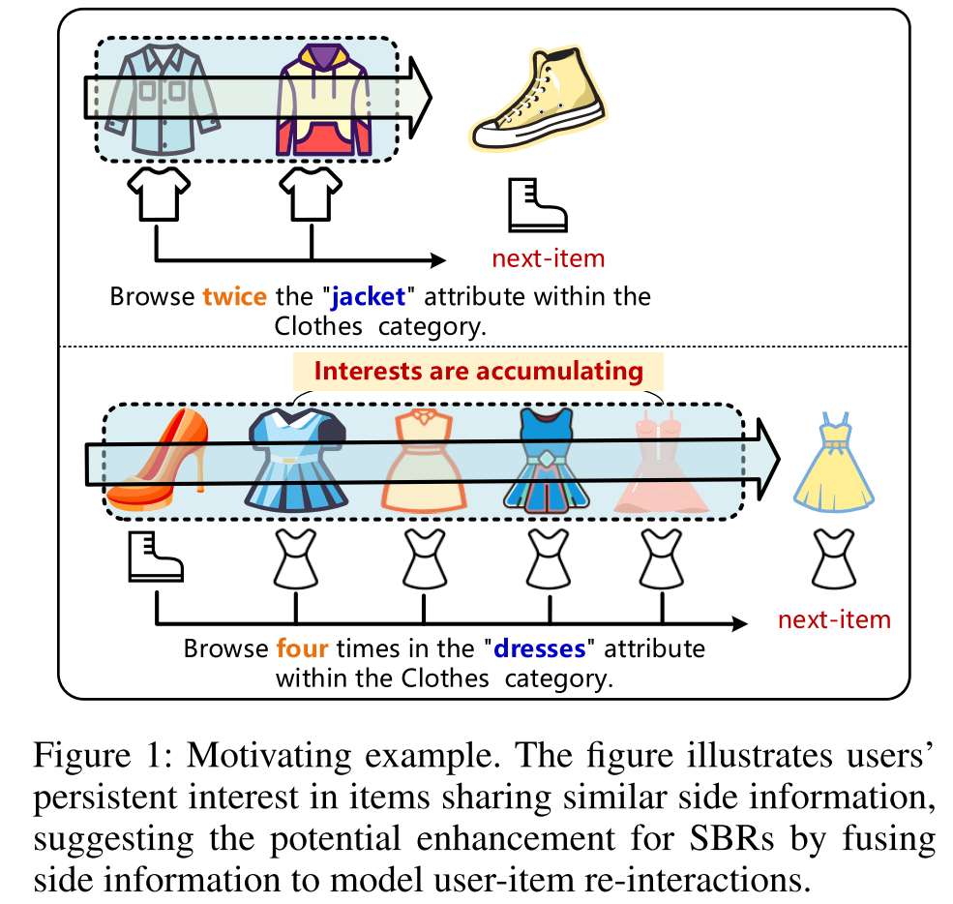
ATAI
AdvancedTechniqueof
Artificial Intelligence
ATAI
ChongqingUniversity _{AdvancedTechniqueof}
of Technology Artificial Intelligence
ChongqingUniversity of Technology
Motivation
1) In previous session-based recommendation methods, the semantic heterogeneity between item IDs and side information introduces computational noise during attention calculation, leading to inconsistencies in user interest modeling and reducing the accuracy of candidate item scoring.
2) previous methods fail to effectively utilize session-based re-interaction patterns, which limits the improvement of candidate item score prediction during the decoding phase.

Slide 3

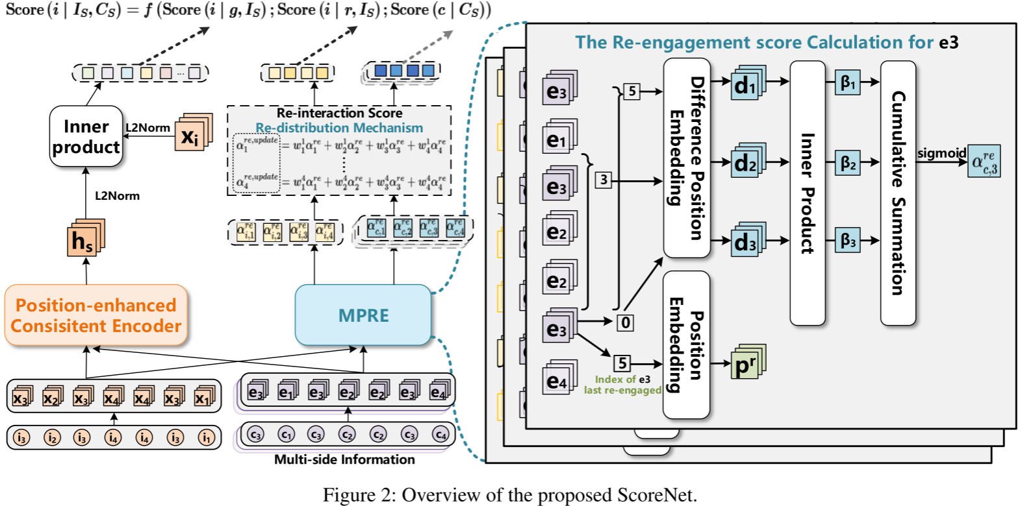
ChongqingUniversity of Technology
ATAI
AdvancedTechniqueof
Artificial Intelligence
ATAI
ChongqingUniversity _{AdvancedTechniqueof}
of Technology Artificial Intelligence
Overview

Slide 4
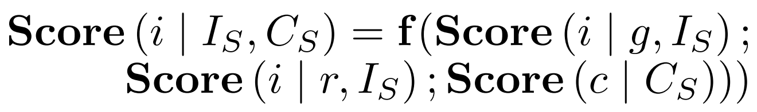
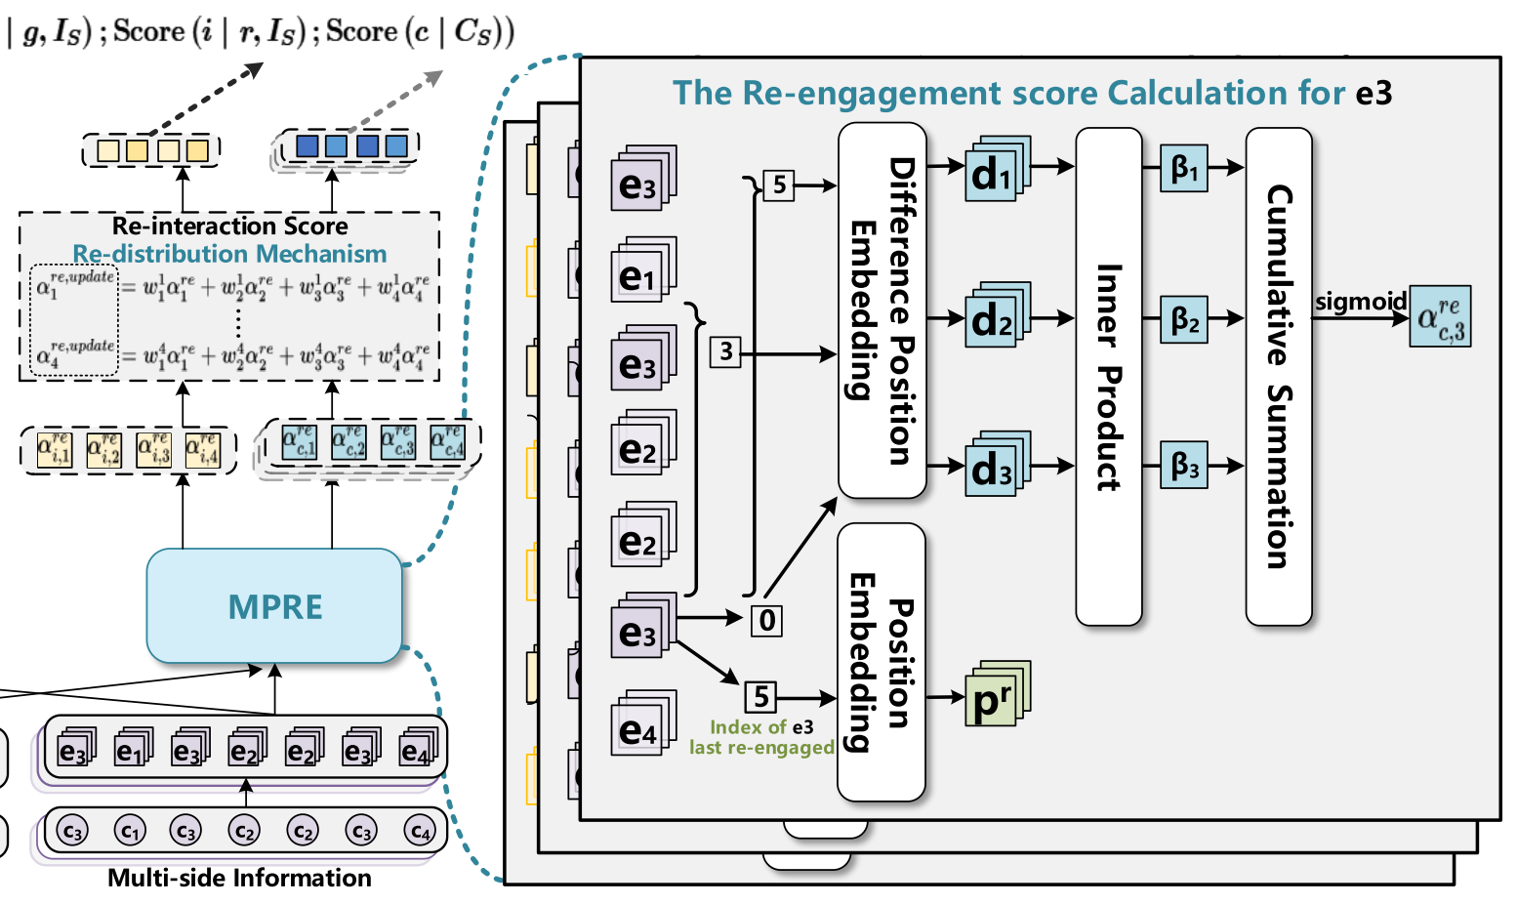
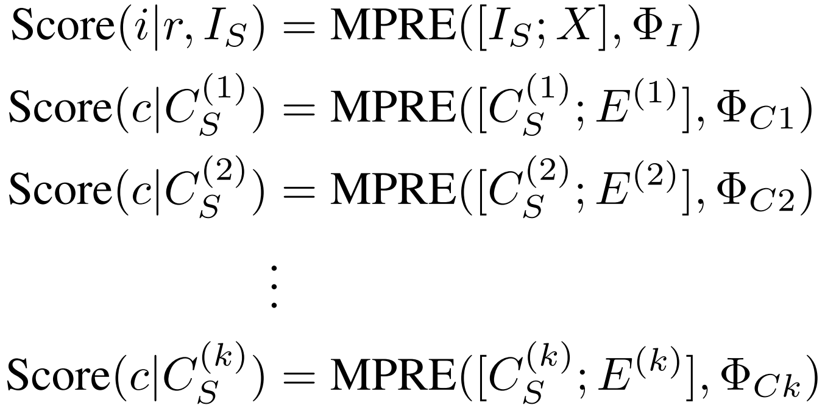
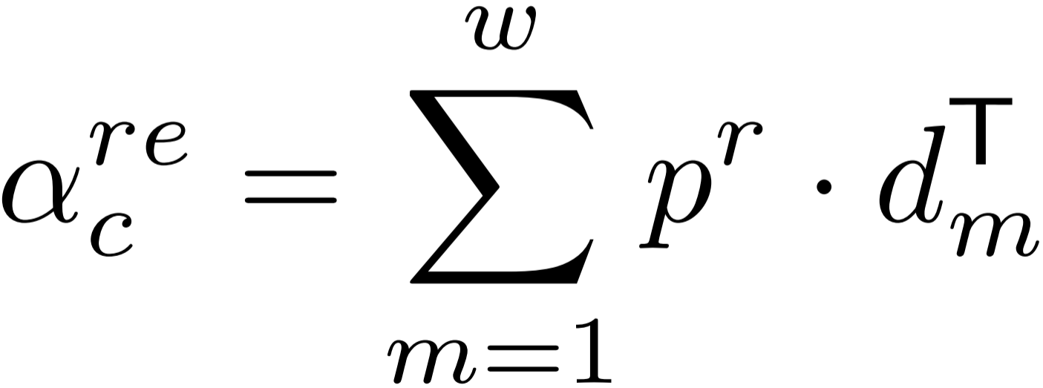
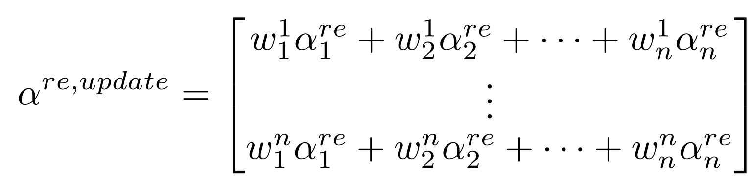
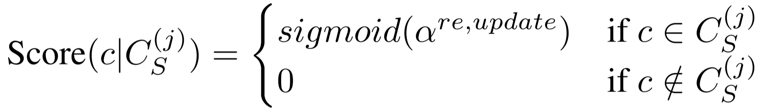
ChongqingUniversity of Technology
ATAI
AdvancedTechniqueof
Artificial Intelligence
ATAI
ChongqingUniversity _{AdvancedTechniqueof}
of Technology Artificial Intelligence
Method
(1)
(2)
(3)
(4)
(5)

Slide 5
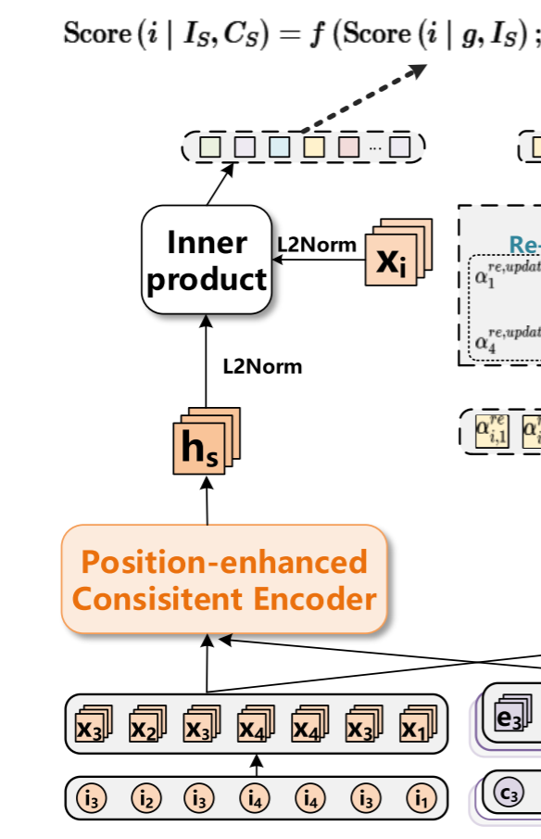
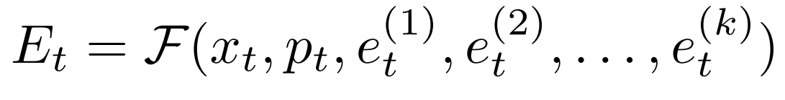
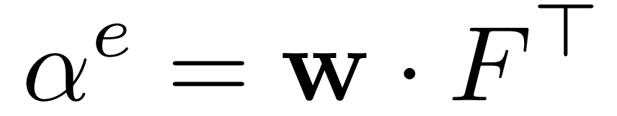
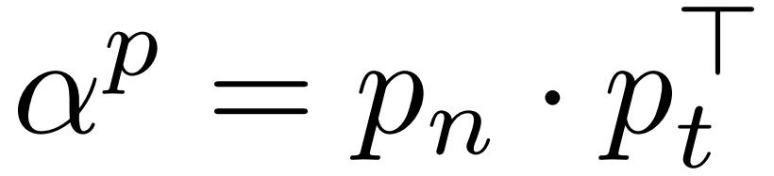
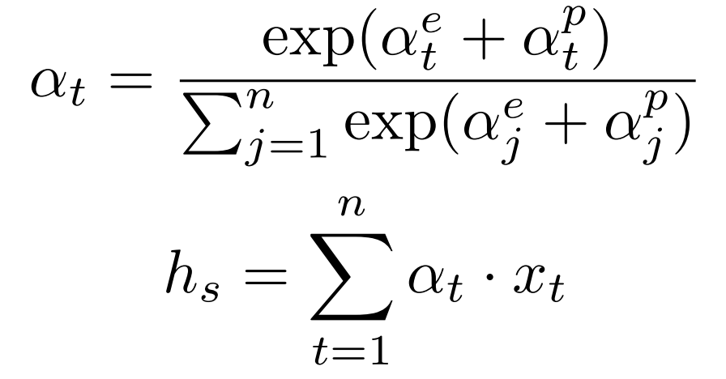
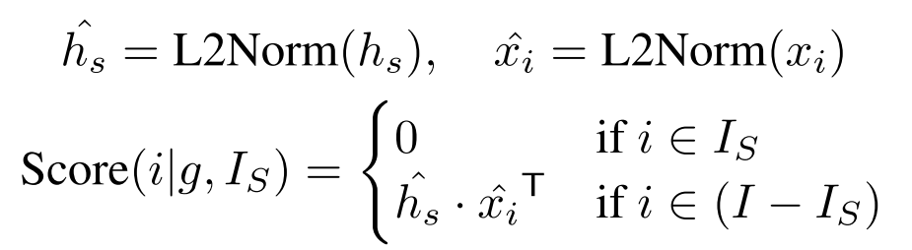
ChongqingUniversity of Technology
ATAI
AdvancedTechniqueof
Artificial Intelligence
ATAI
ChongqingUniversity _{AdvancedTechniqueof}
of Technology Artificial Intelligence
Method
(6)
(7)
(8)
(9)
(10)
(11)
(12)

Slide 6
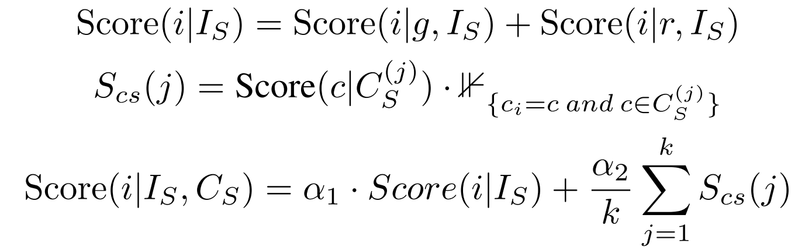
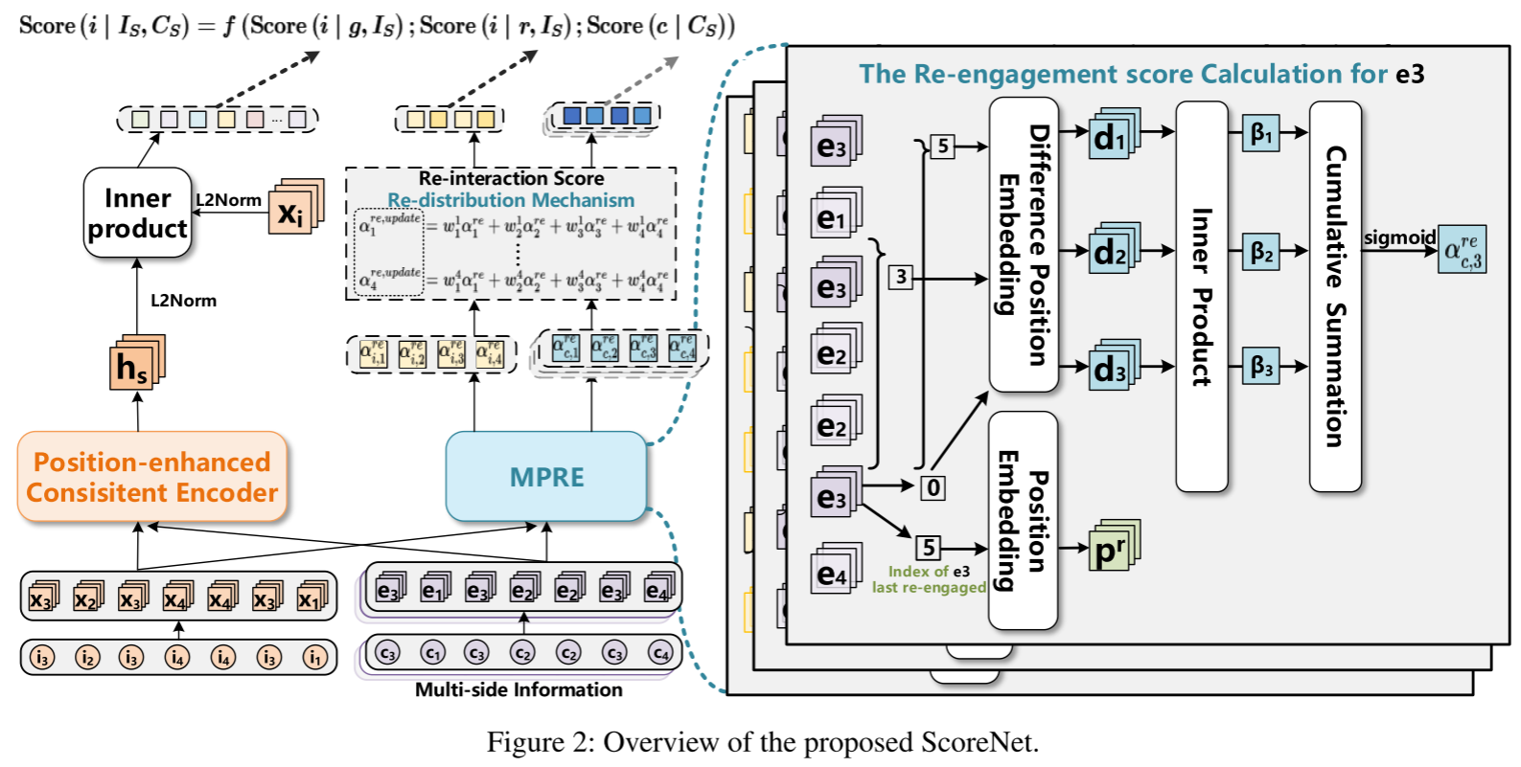
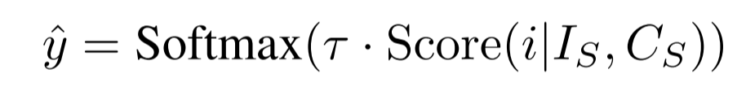
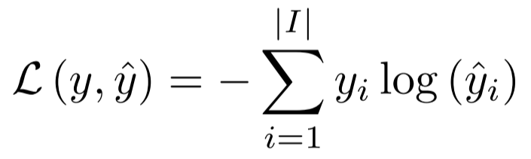
ChongqingUniversity of Technology
ATAI
AdvancedTechniqueof
Artificial Intelligence
ATAI
ChongqingUniversity _{AdvancedTechniqueof}
of Technology Artificial Intelligence
Method
(13)
(14)
(15)

Slide 7

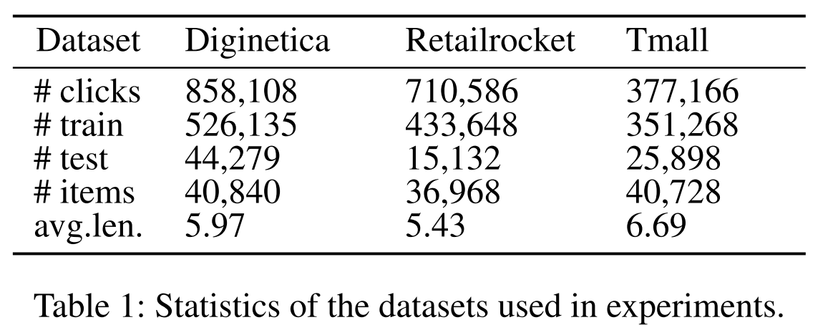
ATAI
AdvancedTechniqueof
Artificial Intelligence
ATAI
ChongqingUniversity _{AdvancedTechniqueof}
of Technology Artificial Intelligence
ChongqingUniversity of Technology
Experiments

Slide 8
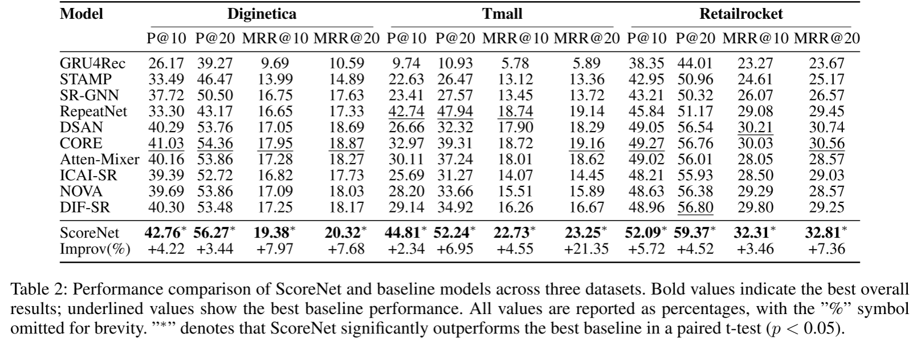
ATAI
AdvancedTechniqueof
Artificial Intelligence
ATAI
ChongqingUniversity _{AdvancedTechniqueof}
of Technology Artificial Intelligence
ChongqingUniversity of Technology
Experiments

Slide 9
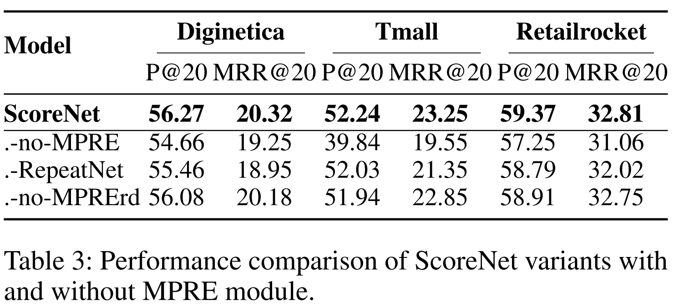
ATAI
AdvancedTechniqueof
Artificial Intelligence
ATAI
ChongqingUniversity _{AdvancedTechniqueof}
of Technology Artificial Intelligence
ChongqingUniversity of Technology
Experiments

Slide 10
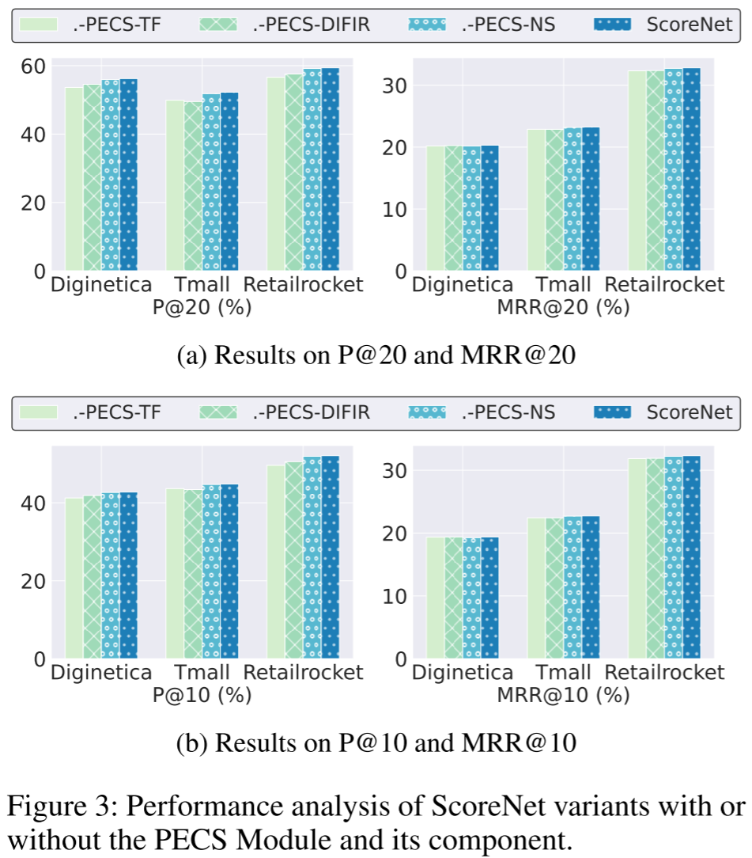
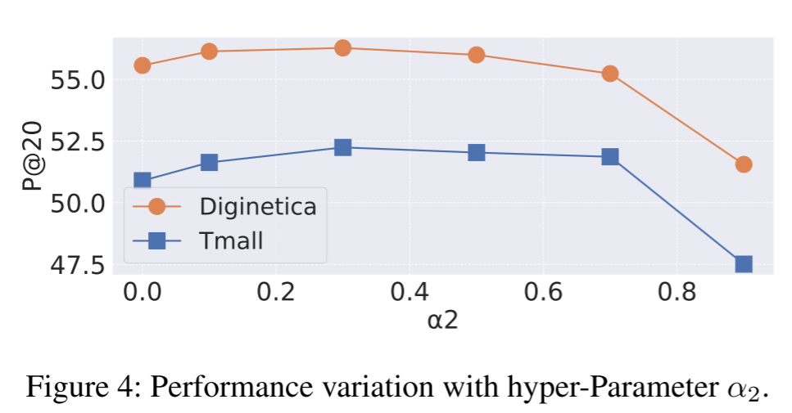
ATAI
AdvancedTechniqueof
Artificial Intelligence
ATAI
ChongqingUniversity _{AdvancedTechniqueof}
of Technology Artificial Intelligence
ChongqingUniversity of Technology
Experiments

Slide 11
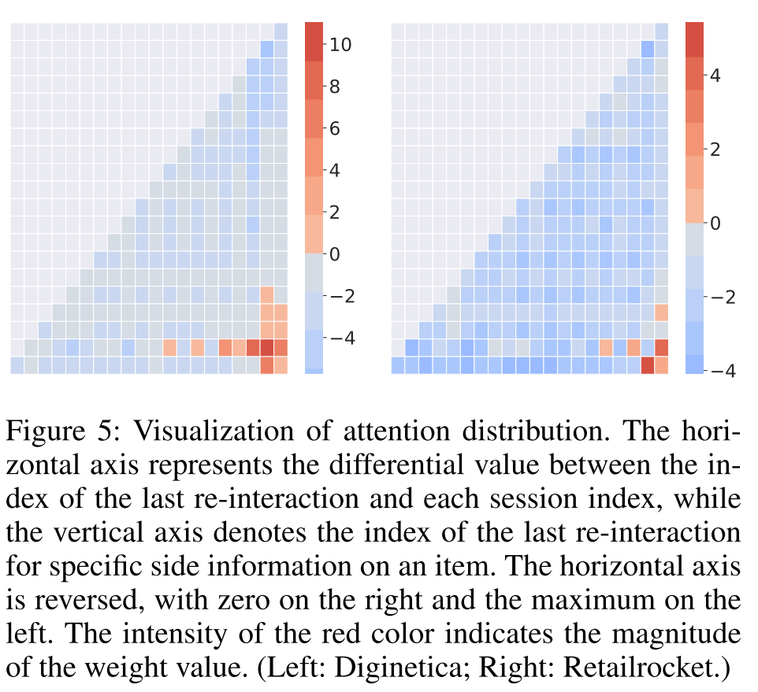
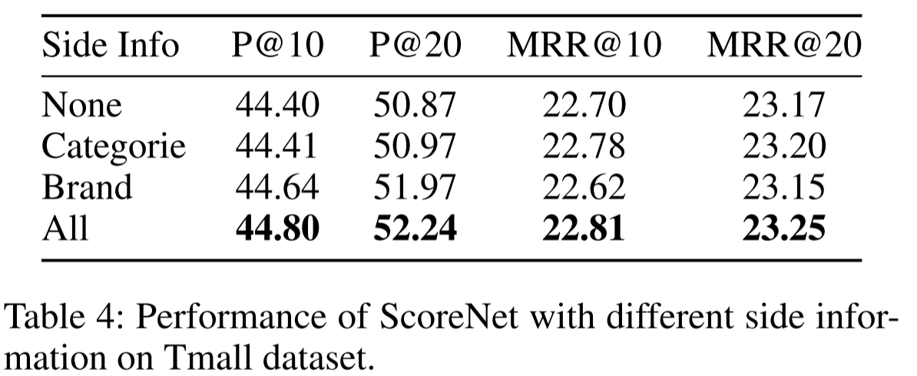
ATAI
AdvancedTechniqueof
Artificial Intelligence
ATAI
ChongqingUniversity _{AdvancedTechniqueof}
of Technology Artificial Intelligence
ChongqingUniversity of Technology
Experiments

Slide 12


ChongqingUniversity of Technology
ATAI
AdvancedTechniqueof
Artificial Intelligence
ATAI
ChongqingUniversity _{AdvancedTechniqueof}
of Technology Artificial Intelligence
Thanks!

